Slide 1
Chapter 13
Curve Fitting and Correlation
This chapter will be concerned primarily with two separate but closely interrelated processes: (1) the fitting of experimental data to mathematical forms that describe their behavior and (2) the correlation between different experimental data to assess how closely different variables are interdependent.

Slide 2
The fitting of experimental data to a mathematical equation is called regression. Regression may be characterized by different adjectives according to the mathematical form being used for the fit and the number of variables. For example, linear regression involves using a straight-line or linear equation for the fit. As another example, Multiple regression involves a function of more than one independent variable.

Slide 3
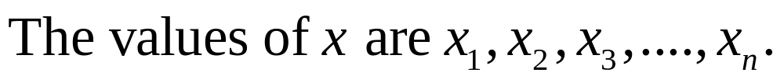
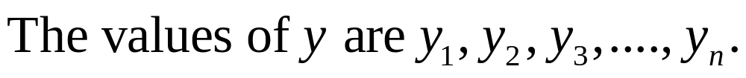

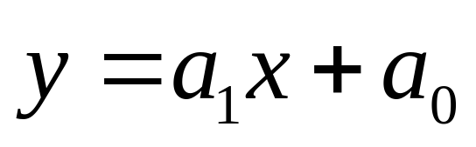
Linear Regression
Assume n points, with each point having values of both an independent variable x and a dependent variable y.

Slide 4
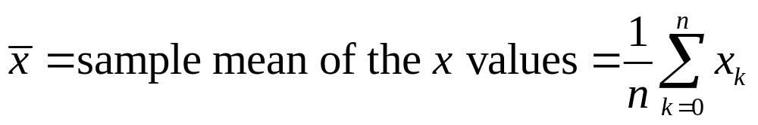
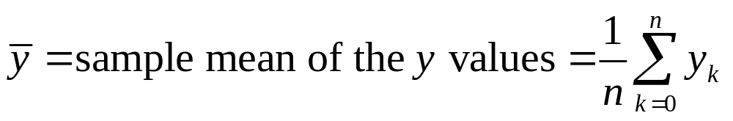
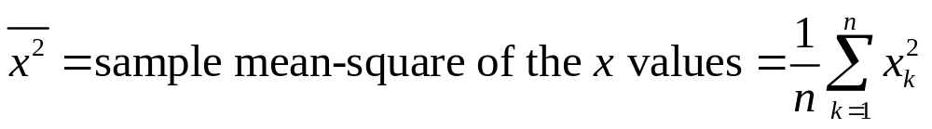
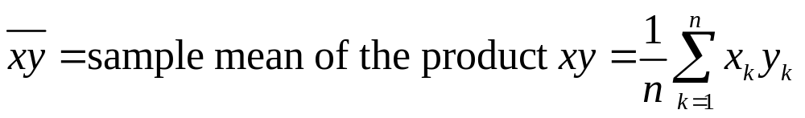
Preliminary Computations

Slide 5
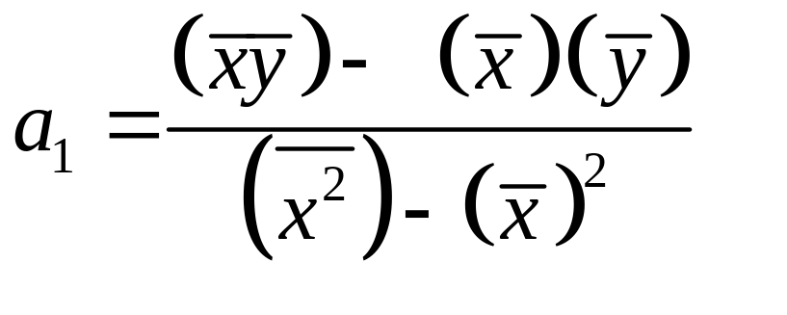
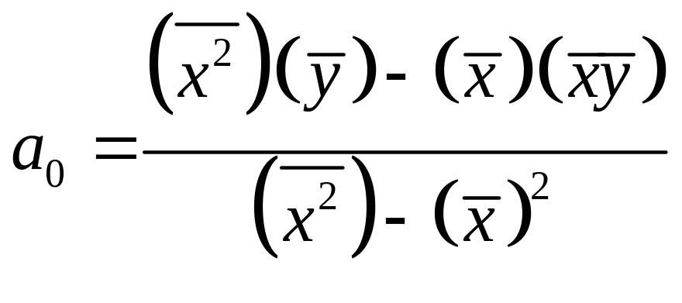
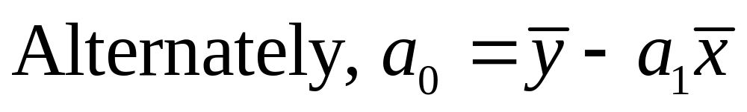

Best-Fitting Straight Line

Slide 6

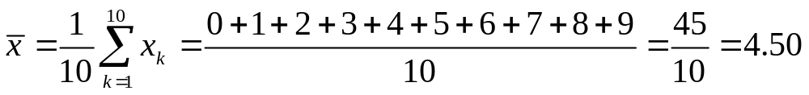
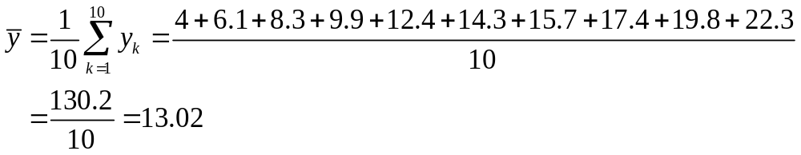
Example 13-1. Find best fitting straight line equation for the data shown below.

Slide 7
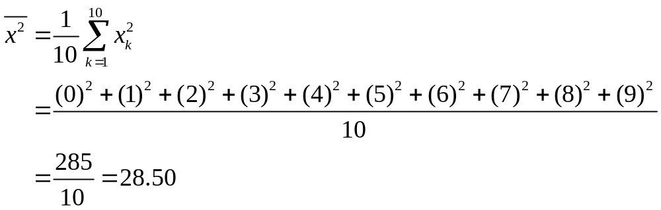
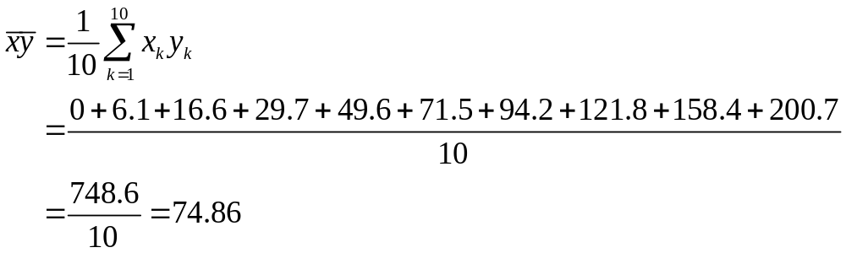
Example 13-1. Continuation.

Slide 8
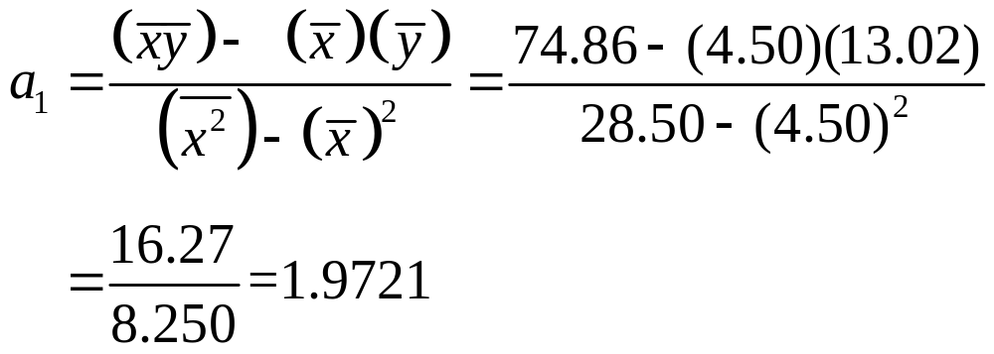
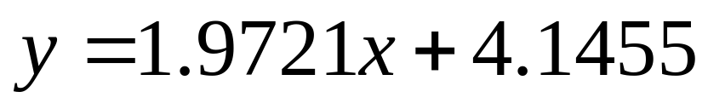
Example 13-1. Continuation.

Slide 9
Example 13-1. Continuation.
>> x = 0:9;
>> yapp = 1.9721*x + 4.1455;
>> y = [the 10 values of y];
>> plot(x, yapp, x, y, 'o')
The best-fit plot and the actual points are shown on the next slide.

Slide 10
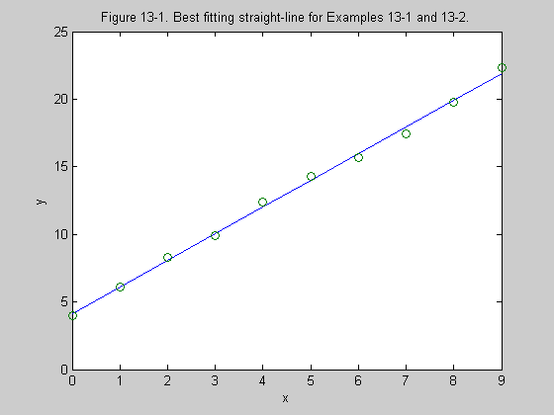

Slide 11
MATLAB General Polynomial Fit
>> x = [x1 x2 x3.......xn];
>> y = [y1 y2 y3......yn];
>> p = polyfit(x, y, m)
>> yapp = polyval(p, x)
>> plot(x, yapp, x, y, 'o')

Slide 12
Example 13-2. Rework Example 13-1 using MATLAB.
>> x = 0:9;
>> y = [the 10 values of y];
>> p = polyfit(x, y, 1)
p =
1.9721 4.1455
These are the same values obtained manually in Example 13-1.

Slide 13
Example 13-3. For data of previous two examples, obtain a 2nd degree fit.
Assume that the vectors x and y are still in memory.
>> p = polyfit(x, y, 2)
p =
0.0011 1.9619 4.1591
>> yapp2 = polyval(p, x);
>> plot(x, yapp2, x, y, 'o')
The results are shown on the next slide.

Slide 14
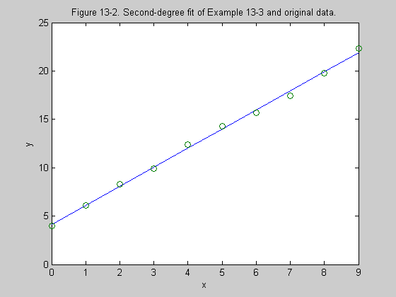

Slide 15
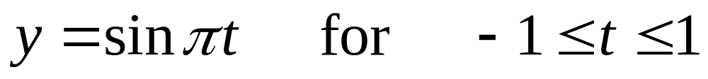
Example 13-4. Determine several polynomial fits for the function below.
>> t = -1:0.05:1;
>> y = sin(pi*t);
>> plot(t, y)
A plot of the function is shown on the next slide.

Slide 16
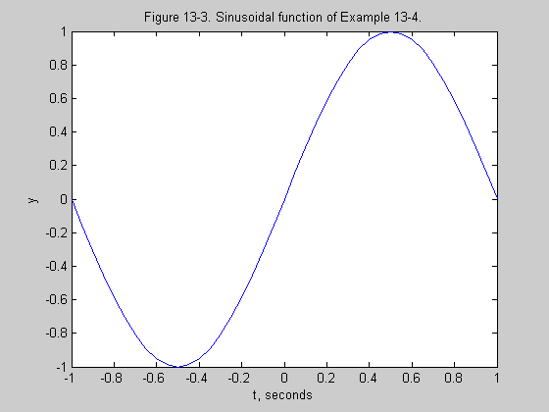

Slide 17
Example 13-4. Continuation.
(a) m = 1
>> p1 = polyfit(t, y, 1)
p1 =
0.8854 0.0000
>> yapp1 = polyval(p1, t);
>> plot(t, yapp1, t, y, 'o')
The results are shown on the next slide.

Slide 18
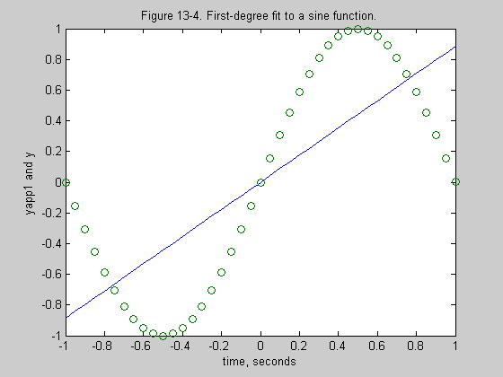

Slide 19
Example 13-4. Continuation.
(b) m = 2
>> p2 = polyfit(t, y, 2)
p2 =
0.0000 0.8854 -0.0000
The polynomial is the same as for m = 1. This is due to the fact that the sine function is an odd function and the coefficients of the terms with even degrees are zero.

Slide 20
Example 13-4. Continuation.
(c) m = 3
>> p3 = polyfit(t, y, 3)
p3 =
-2.8139 -0.0000 2.6568 0.0000
>> yapp3 = polyval(p3, t);
>> plot(t, yapp3, t, y, 'o')
The results are shown on the next slide. A fit for m = 4 would be the same as for m = 3.

Slide 21
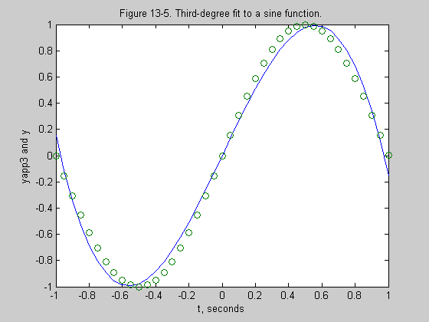

Slide 22
Example 13-5. Continuation.
m = 5
>> p5 = polyfit(t, y, 5)
p5 =
1.6982 0.0000 -4.7880 -0.0000 3.0990 0.0000
>> yapp5 = polyval(p5, t);
>> plot(t, yapp5, t, y, 'o')
The results are shown on the next slide.

Slide 23
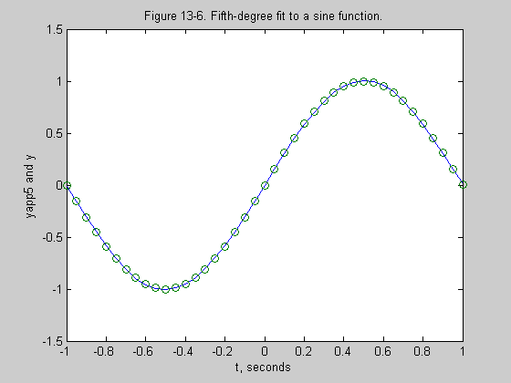

Slide 24
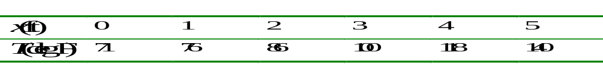
Example 13-5. For data below, obtain a 2nd degree fit for the temperature T as a function of the distance x.
>> x = 0:5;
>> T = [71 76 86 100 118 140];
>> p = polyfit(x,T,2)
p =
2.0893 3.4107 70.8214

Slide 25

Example 13-5. Continuation.
>> x1 = 0:0.1:5;
>> T1 = polyval(p, x1);
>> plot(x1, T1, x, T, 'o')
The results are shown on the next slide.

Slide 26
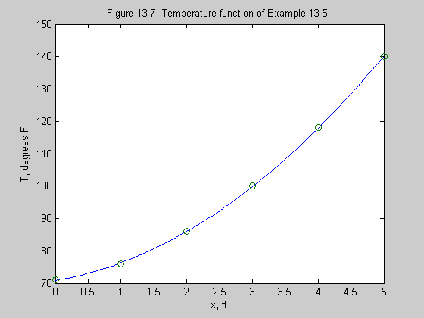

Slide 27
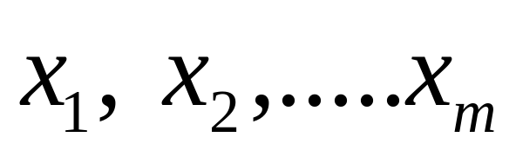
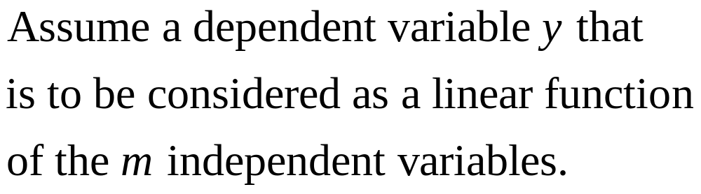
Multiple Linear Regression

Slide 28

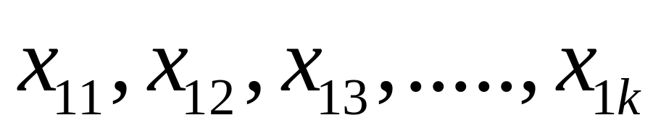

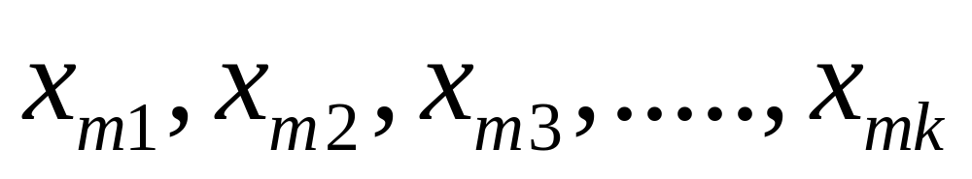
Multiple Regression
(Continuation)

Slide 29
MATLAB Procedure for Linear Regression
1. Form m column vectors each of length k representing the independent variables.
>> x1 = [x11 x12 x13......x1k]';
>> x2 = [x21 x22 x23......x2k]';
.
.
>> xm = [xm1 xm2 xm3.....xmk]';

Slide 30
MATLAB Procedure
(Continuation)
2. Form a column vector of length k representing the dependent variable y.
>> y = [y1 y2 y3.....yk]';
3. Form a rectangular matrix X of size k by m+1 as follows:
>> X= [ones(size(x1)) x1 x2 ......xm];
4. Determine a column vector a of length m+1 by the command that follows:
>> a = X\y

Slide 31
MATLAB Procedure
(Continuation)
5. The best-fit linear multiple regression formula is then given by
>> Y = X*a;
6. The maximum difference between the actual data and the formula is
>> Error_Maximum = max(abs(Y-y))

Slide 32

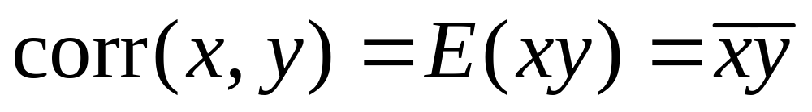

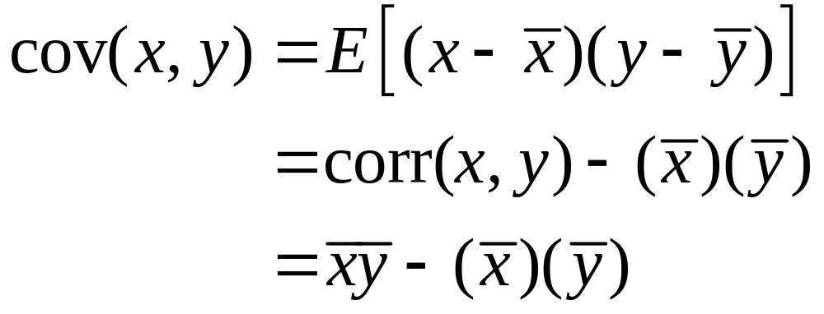
Correlation

Slide 33
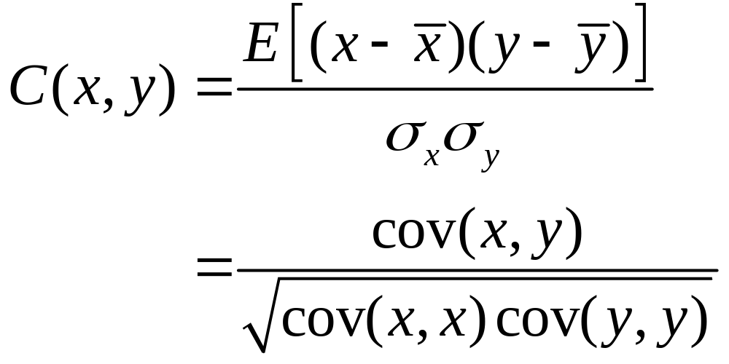
Correlation Coefficient

Slide 34
Implications of Correlation Coefficient
1. If C(x, y) = 1, the two variables are totally correlated in a positive sense.
2. If C(x, y) = -1 , the two variables are totally correlated in a negative sense.
3. If C(x, y) = 0, the two variables are said to be uncorrelated.

Slide 35
One Final Note
Correlation does
not necessarily
imply causation!

